Slide 1

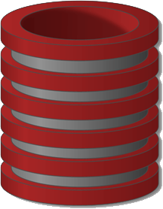
NoSQL and MongoDB
Huy Pham Ngoc
22/12/2015
Technical seminar

Slide 2
Objectives
Introduce NoSQL database
About NoSQL databases type (Key-value stores, Document databases, Wide column stores, and Graph databases, etc.)
Introduction to MongoDB database
Demo (Spring and MongoDB)

Slide 3
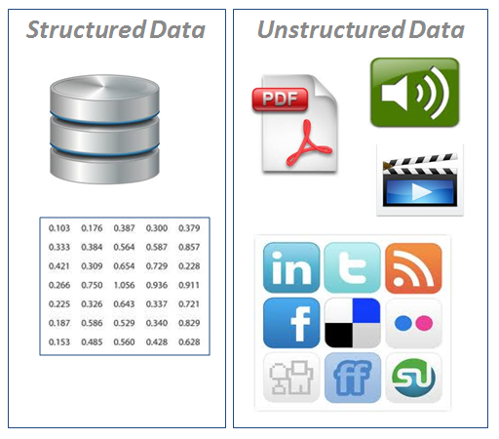
Limitations of SQL databases
Scale
Unstructured data storage
Performance

Slide 4

Question ?
What database actually Facebook uses?
The only answer: NoSQL

Slide 5
What is NoSQL
Next Generation Databases mostly addressing some of the points:
non-relational.
distributed.
open-source.
horizontally scalable. (scale out)
Not Only SQL, Non Relational SQL.
Notes:
Shortcomings of RDBMS
RDBMS is sufficient to store and manipulate all the structured data efficiently but in today’s world the velocity and nature of data used/generated over the Internet is growing exponentially. As we can often see in areas like social media, the data used has no specific structure boundary. This makes unavoidable the need to handle unstructured data which is non-relational and schema-less in nature. For RDBMS it becomes a real challenge to provide the cost effective and fast Create, Read, Update and Delete (CRUD) operation as it has to deal with the overhead of joins and maintaining relationships amongst various data. Therefore a new mechanism is required to deal with such data in an easy and efficient way. This is where NoSQL comes into the picture to handle unstructured BIG data in an efficient way to provide maximum business value and customer satisfaction.
Reference : http://www.3pillarglobal.com/insights/short-history-databases-rdbms-nosql-beyond

Slide 6
NoSQL
In 2006 Google published BigTable paper.
In 2007 Amazon presented DynamoDB.
It didn’t take long for all these ideas to used in:
Several open source projects (Hbase, Cassandra) and
Other companies (Facebook, Twitter, …)
List of NoSQL Databases (currently > 250)
Deal with limitations of SQL databases, particularly concerning scale and unstructured data storage
Notes:
NoSQL
NoSQL is not a campaign against the SQL language. NoSQL stands for “Not Only SQL.” It provides more possibilities beyond the classic relational approach of data persistence to the developers. NoSQL refers to a broad class of non-relational databases that differ from classical RDBMS in some significant aspects, most notably because they do not use SQL as their primary query language, instead providing access by means of Application Programming Interfaces (APIs). The reason behind such a big switch or in other words the advantages of NoSQL are the following:
High scalability
Distributed Computing
Lower cost
Schema flexibility
Un/semi-structured data
No complex relationships
Reference : http://www.3pillarglobal.com/insights/short-history-databases-rdbms-nosql-beyond

Slide 7
Different Types of NoSQL
Column Store
Column data is saved together, as opposed to row data
Super useful for data analytics
Hadoop, Cassandra, Hypertable
Key-Value Store
A key that refers to a payload
MemcacheDB, Azure Table Storage, Redis
Document / XML / Object Store
Key (and possibly other indexes) point at a serialized object
MongoDB, CouchDB, RavenDB
Graph Store
Nodes are stored independently, and the relationship between nodes (edges) are stored with data

Slide 8
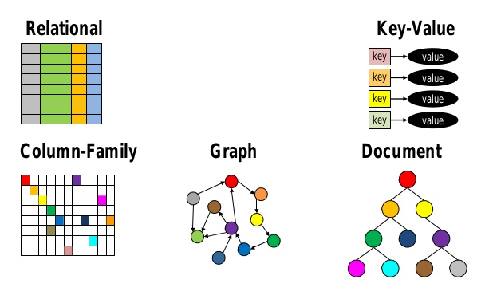
Different Types of NoSQL(cont'd)

Slide 9
NoSQL PROS
Elastic scalability
Very fast for adding new data and for simple operations/queries.
Ability to store complex data types (for document based solutions) in a single item of storage.
Economy.

Slide 10
NoSQL CONS
Immaturity
Possible database administration issues
Not ready ACID (Atomicity, Consistency, Isolation, Durability)
Complex consistency models
Still not support all of standardization

Slide 11
NoSQL vs. SQL Summary
 | SQL Databases | NOSQL Databases
Types | One type (SQL database) with minor variations | Many different types including key-value stores, document databases, wide-column stores, and graph databases
Development History | Developed in 1970s to deal with first wave of data storage applications | Developed in 2000s to deal with limitations of SQL databases, particularly concerning scale, replication and unstructured data storage
Examples | MySQL, Postgres, Oracle Database | MongoDB, Cassandra, HBase, Neo4j
Scaling | Vertically (scale up) | Horizontally (scale out)
Data Manipulation | SELECT, FROM, WHERE,… | Through object-oriented APIs
Consistency | Can be configured for strong consistency | Depends on product. Some provide strong consistency (e.g., MongoDB)

Slide 12
When to use NoSQL
Elastic scalability
Big data applications
Query on large data set
Flexible schema and flexible datatypes
Not ACID
Economy

Slide 13
MongoDB
An Open Source Document oriented database
Dynamic schemas, storing data in JSON style documents that allows for addition of data on the fly
Supports indexing of documents
Auto-sharding supported, providing full horizontal scaling.

Slide 14
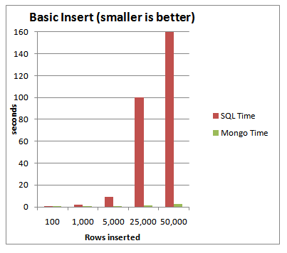
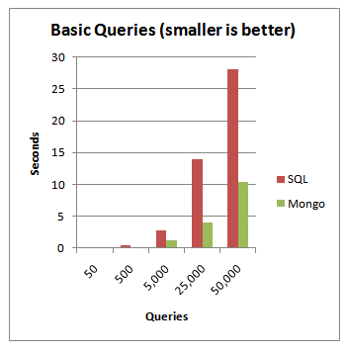
MongoDB vs. NoSQL Server 2008

Slide 15
Terminology
RDBMS | MongoDB
Database | Database
Table | Collection
Index | Index
Row | Document or BSON document
Column | Field
Table Join | Embedding & Linking
Notes:
Let’s talk about some the terms.
JOINS: RDBMS uses Join to stich together fundamentally simple things into larger, more complex data.
MongoDB uses embedding of data within data and linking to produce the same result.

Slide 16
What is a Document?
{
_id : “bob”,
name: ”Bob Nobooks",
address: {
street: ”139 W45 St. ",
city: ”NY",
state: ”NY",
country: ”USA”
}
}

Slide 17
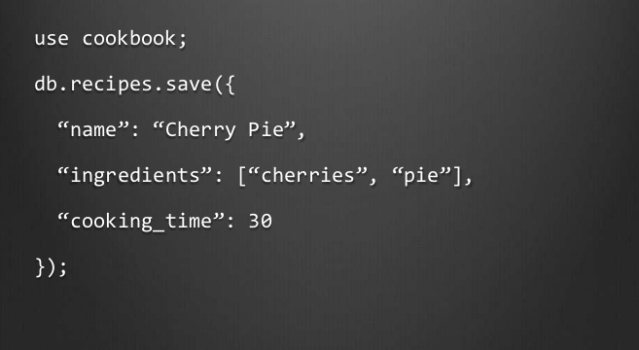
Inserts

Slide 18
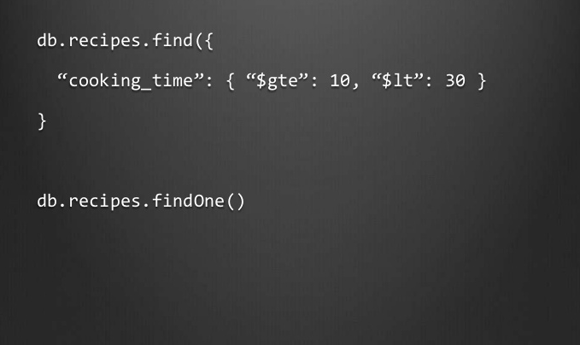
Searching

Slide 19

Some More Advanced Syntax

Slide 20
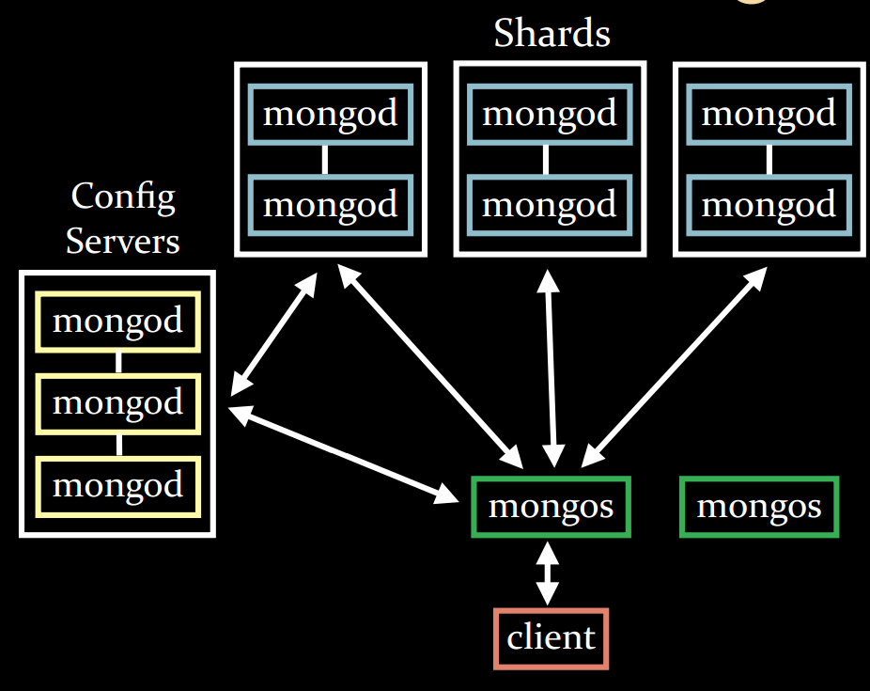
Auto Sharding

Slide 21
Demo Spring MVC and MongoDB
IDE: Eclipse Luna
Database server: MongoDB v3.07
Dependency: Spring Data MongoDB v1.8.1
Java v1.7
Spring Framework v4.0

Slide 22
Spring & MongoDB Fit Together
Spring enables complete configuration of the Controller, Service, DAO Layer and facilitates connection to Mongo DB
Servlet Engine (e.g. Tomcat)
Controller Layer
Service Layer
DAO Layer
Request
Front Controller (Spring Dispatcher)
Repository
Mongo DB
Response
Controller
Mongo Repository

Slide 23
Thanks you
Any questions ?

Slide 24
References
An Introduction to NoSQL databases
http://nosql-database.org/
https://en.wikipedia.org/wiki/NoSQL
Data MongoDB - Reference Documentation
https://docs.mongodb.org/manual/
http://docs.spring.io/spring-data/data-mongo/docs/1.8.0.RELEASE/reference/html/#new-features.1-8-0.
MongoDB vs. SQL Server 2008 Performance Showdown
http://blog.michaelckennedy.net/2010/04/29/mongodb-vs-sql-server-2008-performance-showdown/

